Slide 1

Commute Times in the US
Joshua Clugston

Slide 2
Introduction
I’m Joshua Clugston, a data analyst apprentice with an B.S. in Applied Mathematics.
I’ll be discussing how commute times vary in the United States and how different factors interact and correlate with commute times.
All data was collected from the Census Bureau (https://data.census.gov) and contains data from 2010 through 2022.
I wanted to specifically investigate how different modes of transportation affect travel times to work. Additionally, I was interested in seeing how age and location influenced which mode of transportation was used.

Slide 3
Motivation
The main reason for pursuing this topic comes from my passion of road infrastructure and why car-dependency is prevalent in the US.
Considering that these topics impact how we travel, finding any correlations to shorter commute times can be important information in lowering overall travel times in the US.

Slide 4
Colors Being Used
represents commute times
represents number of workers
represents people using public transportation
represents people who carpool
represents people who drive alone

Slide 5
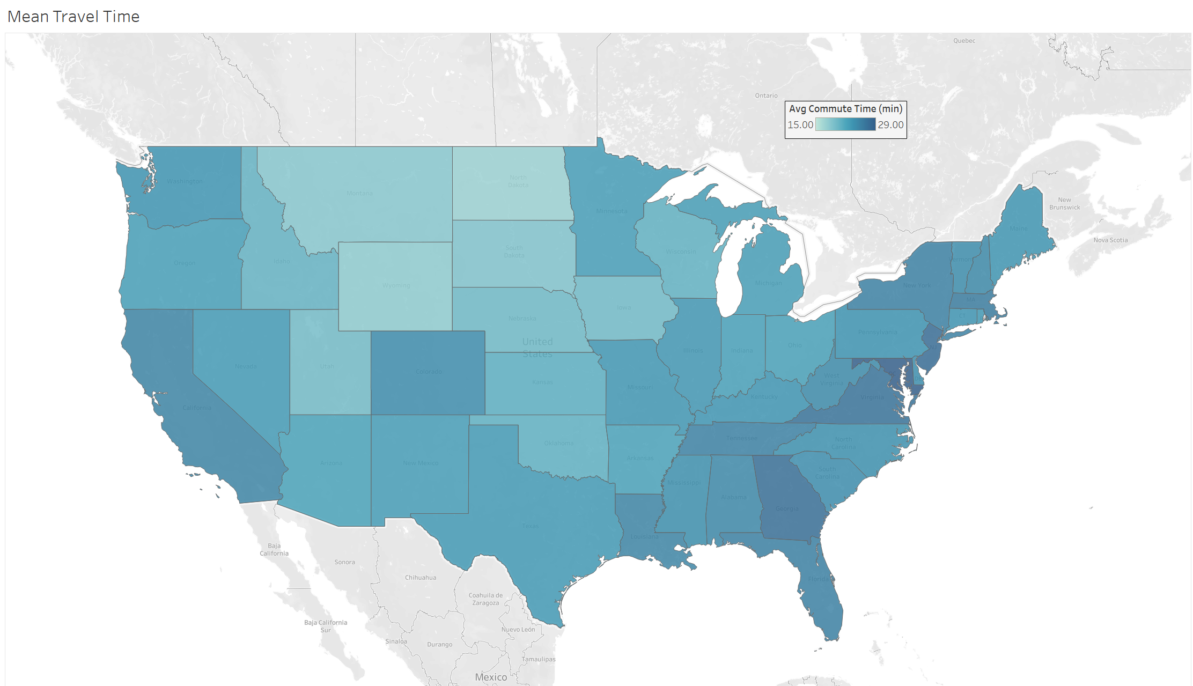
National average commute time is 24 minutes

Slide 6
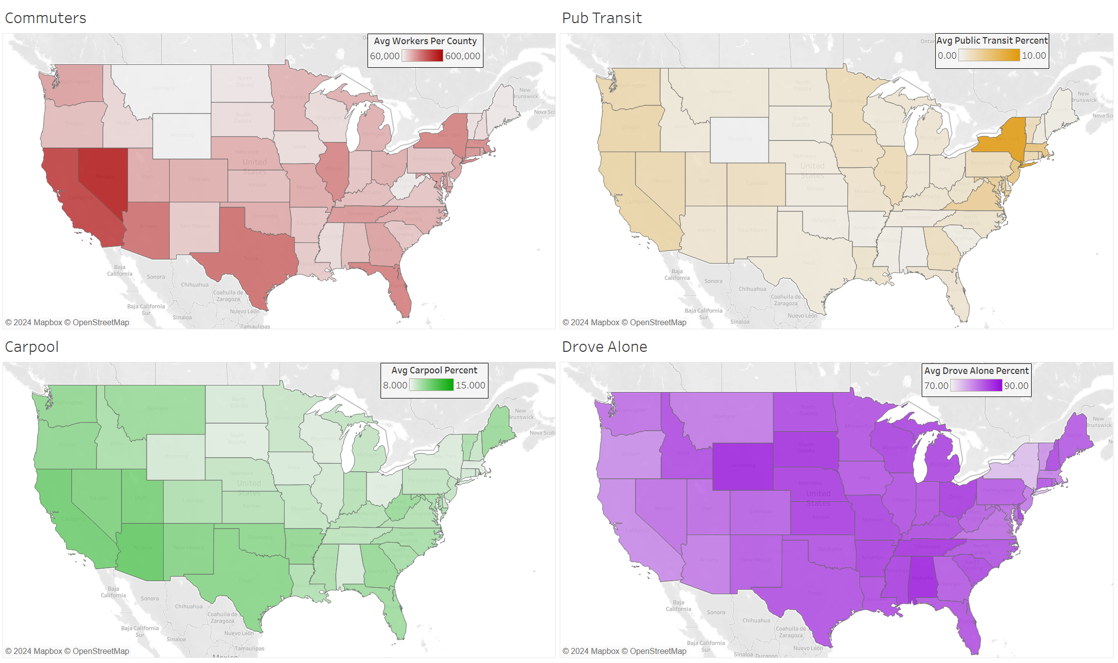

Slide 10
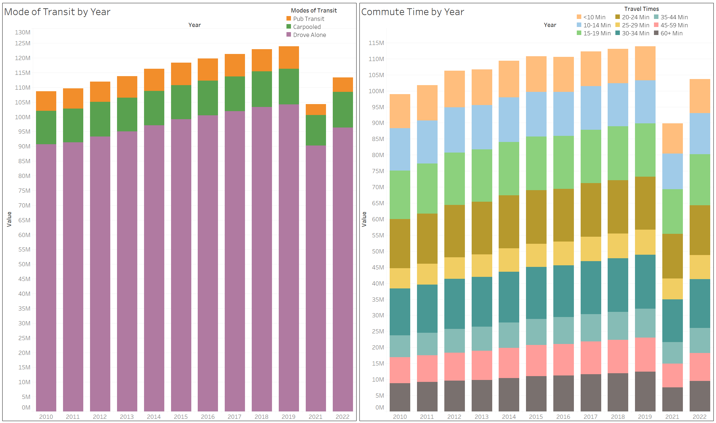
How Many People Are Using Each Mode of Transportation?
It’s easy to see that driving alone is by far the most used method of transportation. Given that the US is heavily car-dependent, this result was expected.

Slide 11
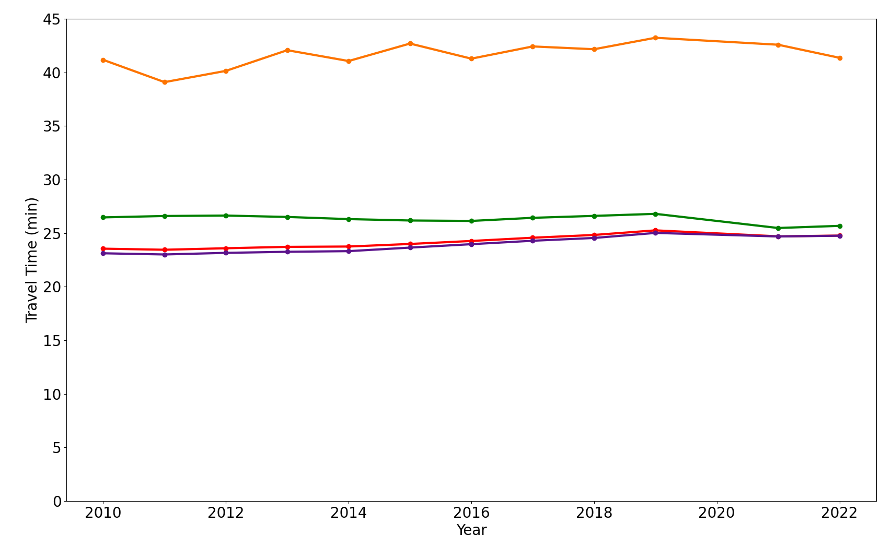
How Long Does Each Mode of Transportation Take?
- Total Avg Travel Time
- Avg Drove Alone Travel Time
- Avg Carpool Travel Time
- Avg Pub Transit Travel Time
The total average and Drove Alone average are very close, indicating a correlation.
Public Transportation takes the longest by far, perhaps explaining why so few people take it.

Slide 12
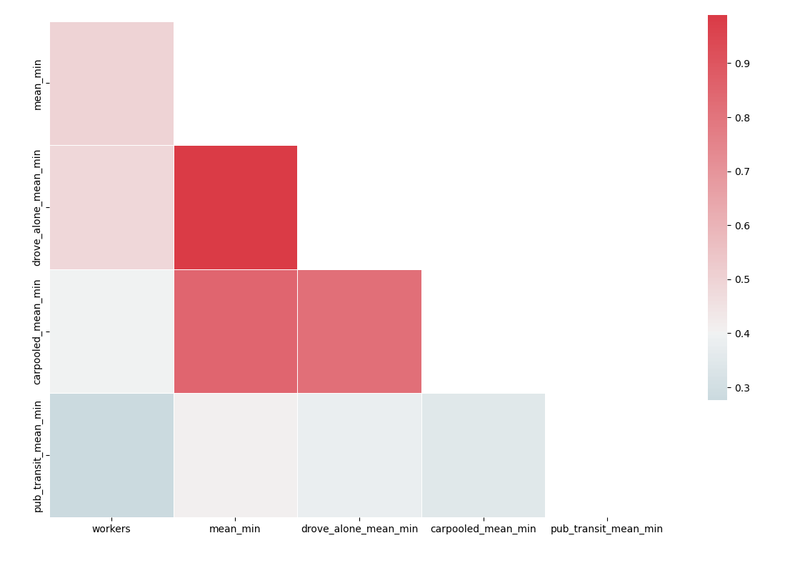
Are There Any Correlations Between Travel Time for Each Mode?
There is a strong correlation between the overall average commute time and the average commute time for people who Drive Alone. Since we know that the vast majority of commuters drive alone, this correlation makes sense.

Slide 13
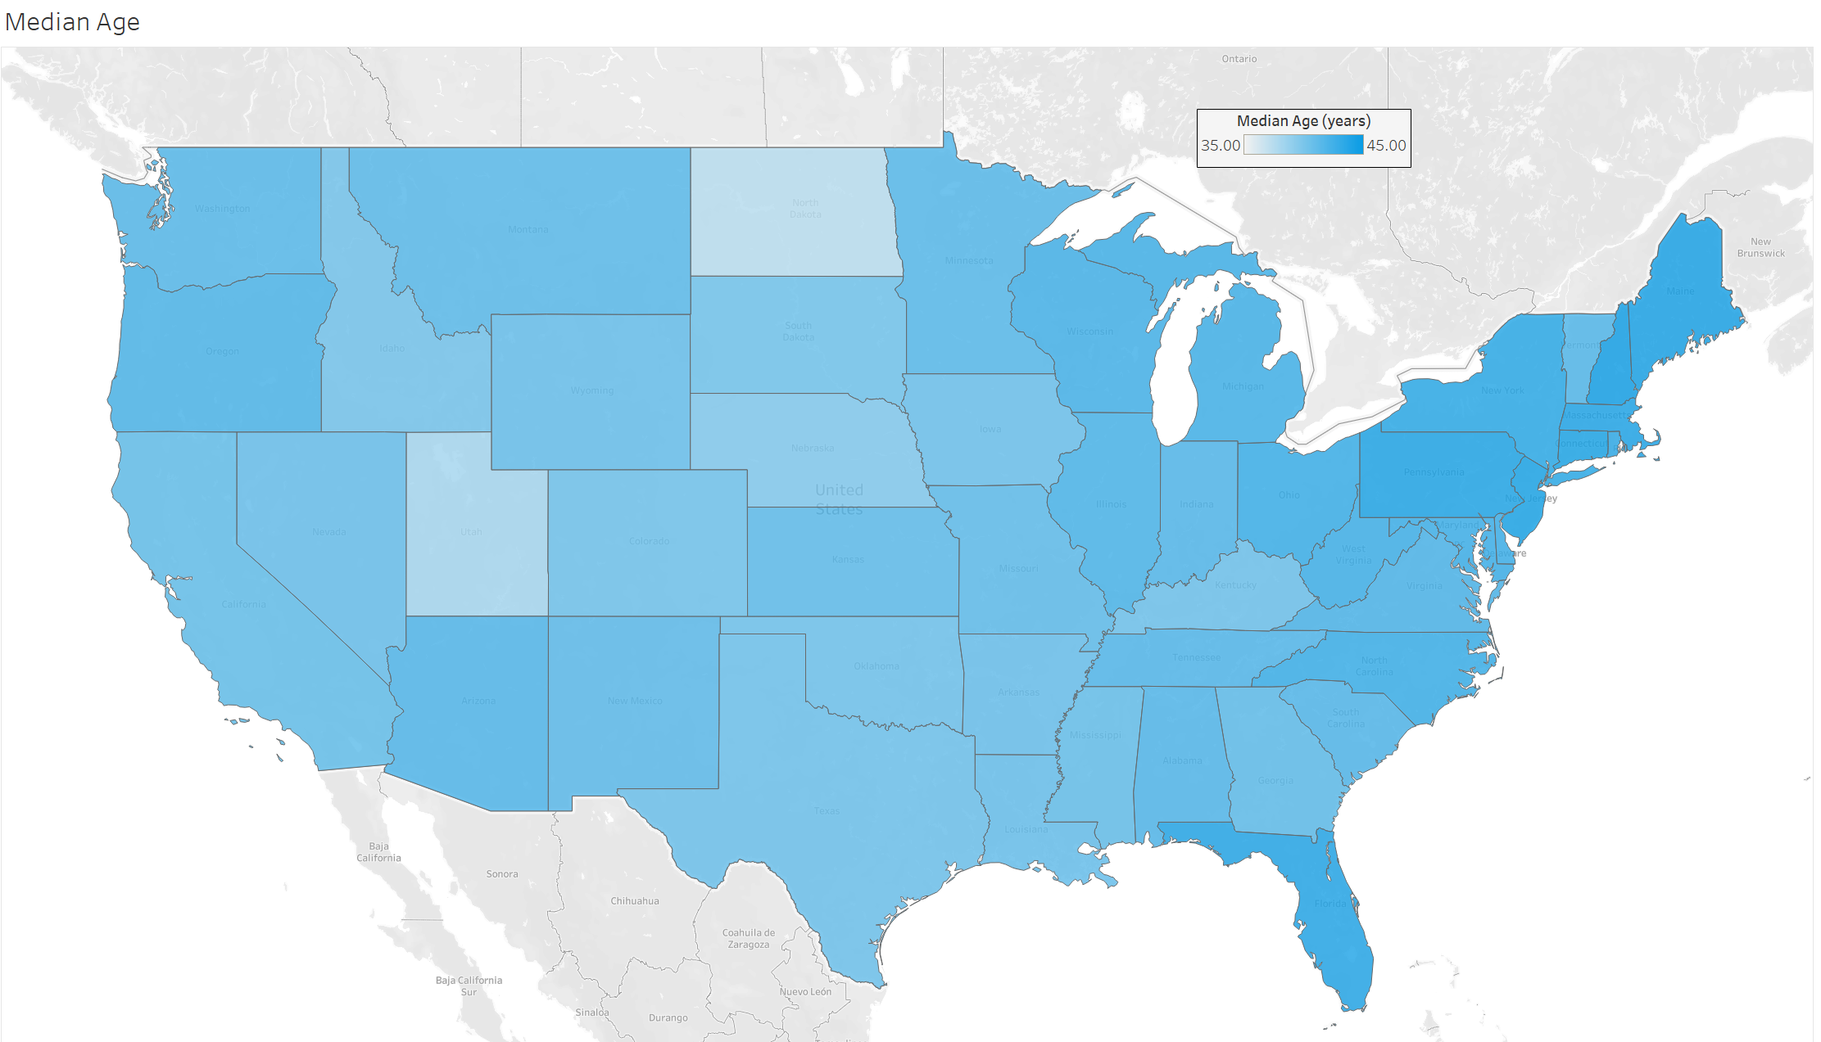
Average age is 41 years old

Slide 14
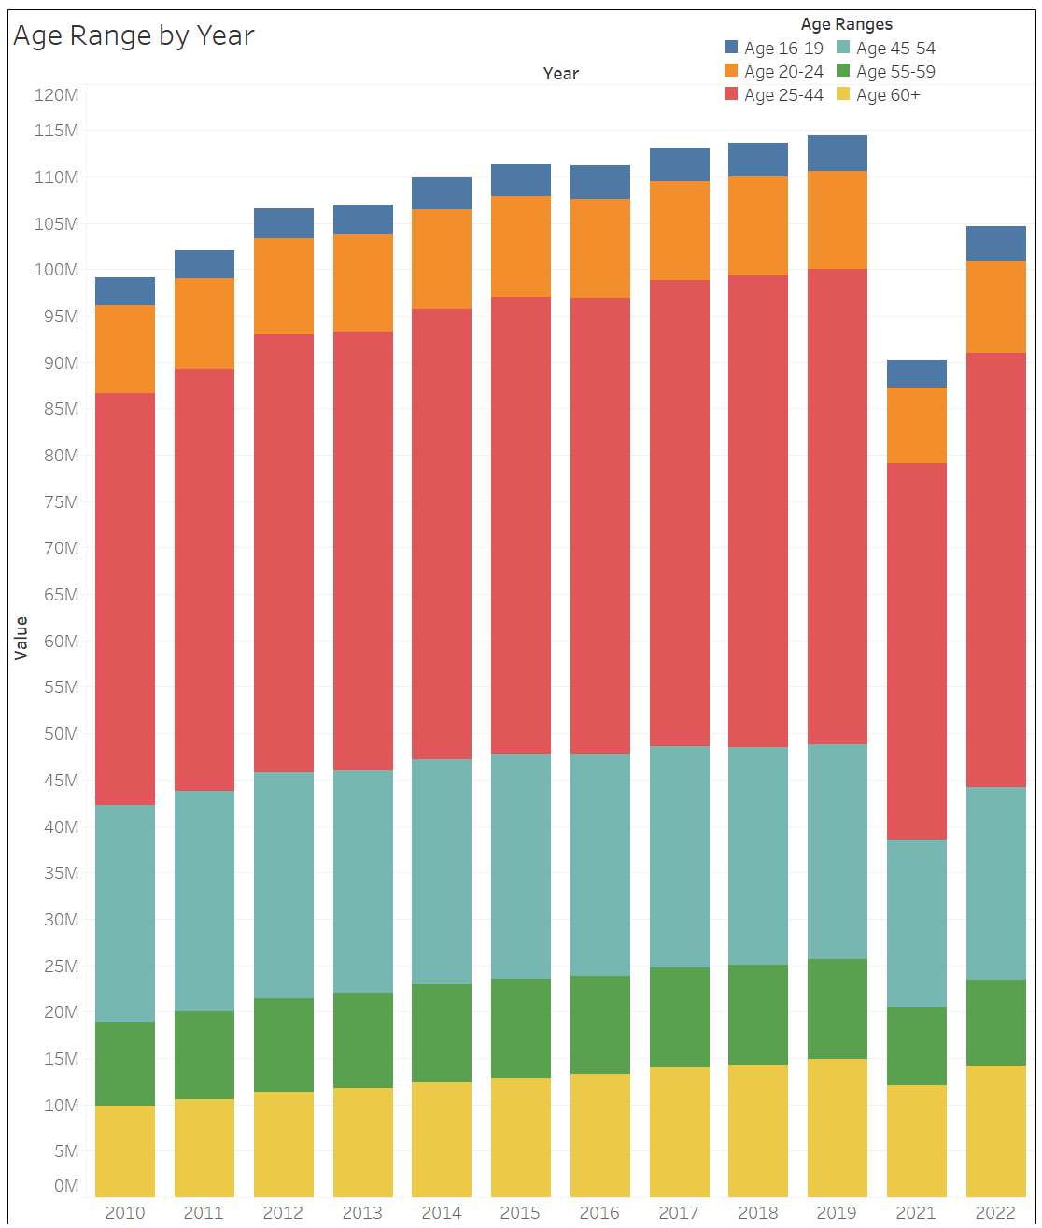
How Old Are Workers Who Commute?
Most people who commute are between 25 and 44, which explains why the average age is 41.
There are a considerable number of workers who are 60 and older, but since 60+ has a large range of ages, it’s not surprising that there are more people in this age group than ages 55-59.

Slide 15
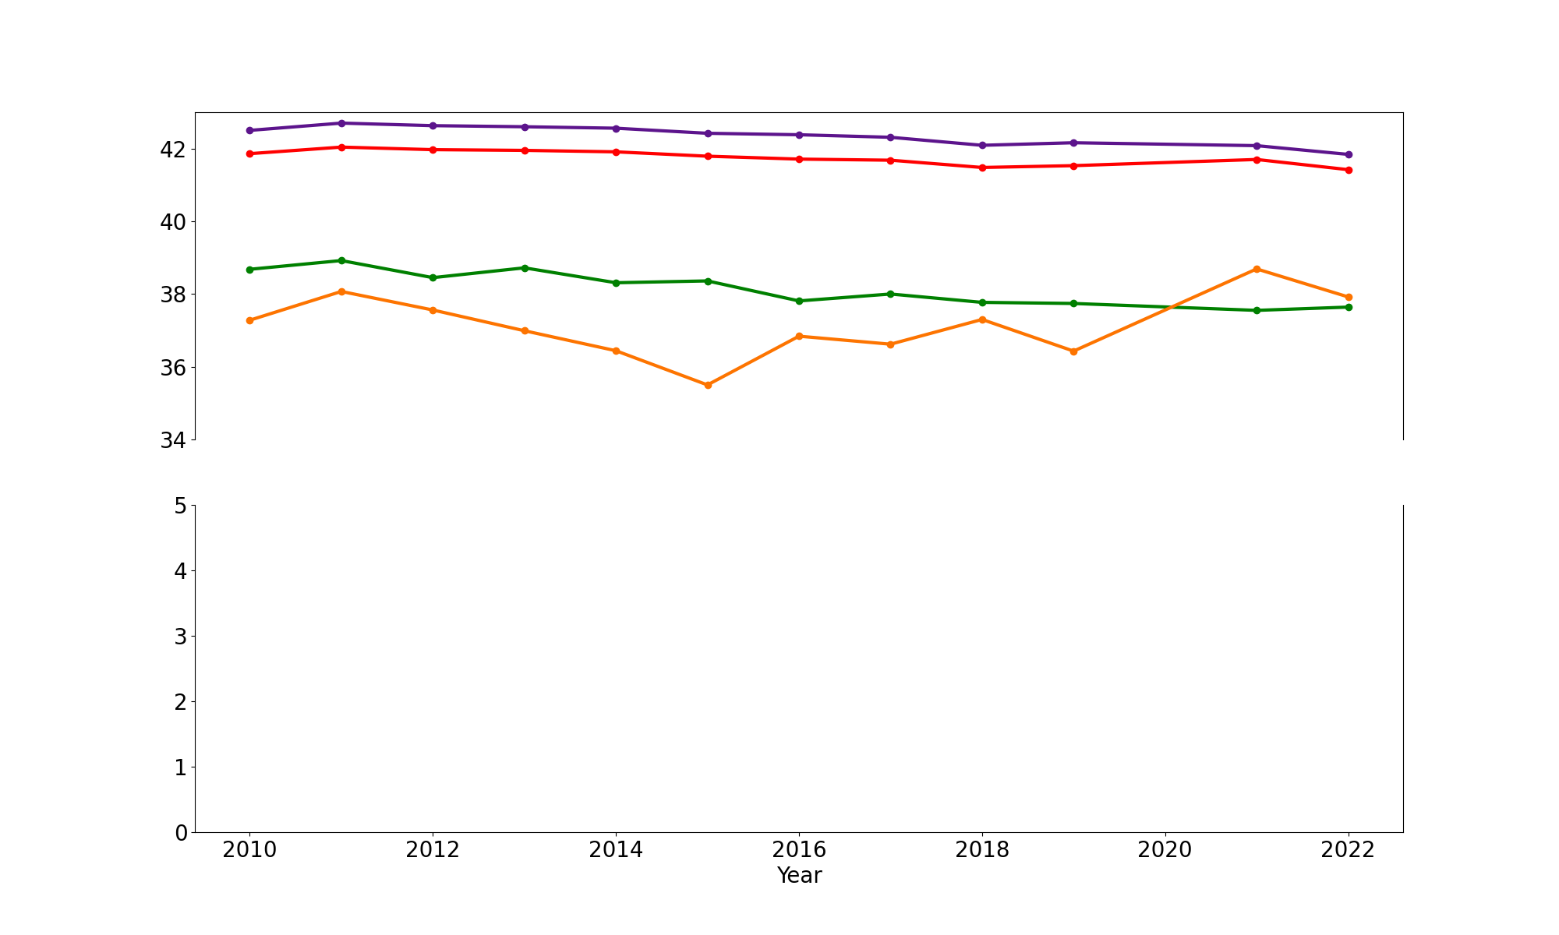
What Are the Median Ages For Each Mode of Transit?
- Total Median Age
- Median Drove Alone Age
- Median Carpool Age
- Median Pub Transit Age
The mode of transit with the highest average age is Driving Alone, which is once again highly correlated with the overall average age.
Public Transit had a jump after 2020. While it’s likely the pandemic influenced this, it’s not exactly clear why.
Average Age (years)

Slide 16
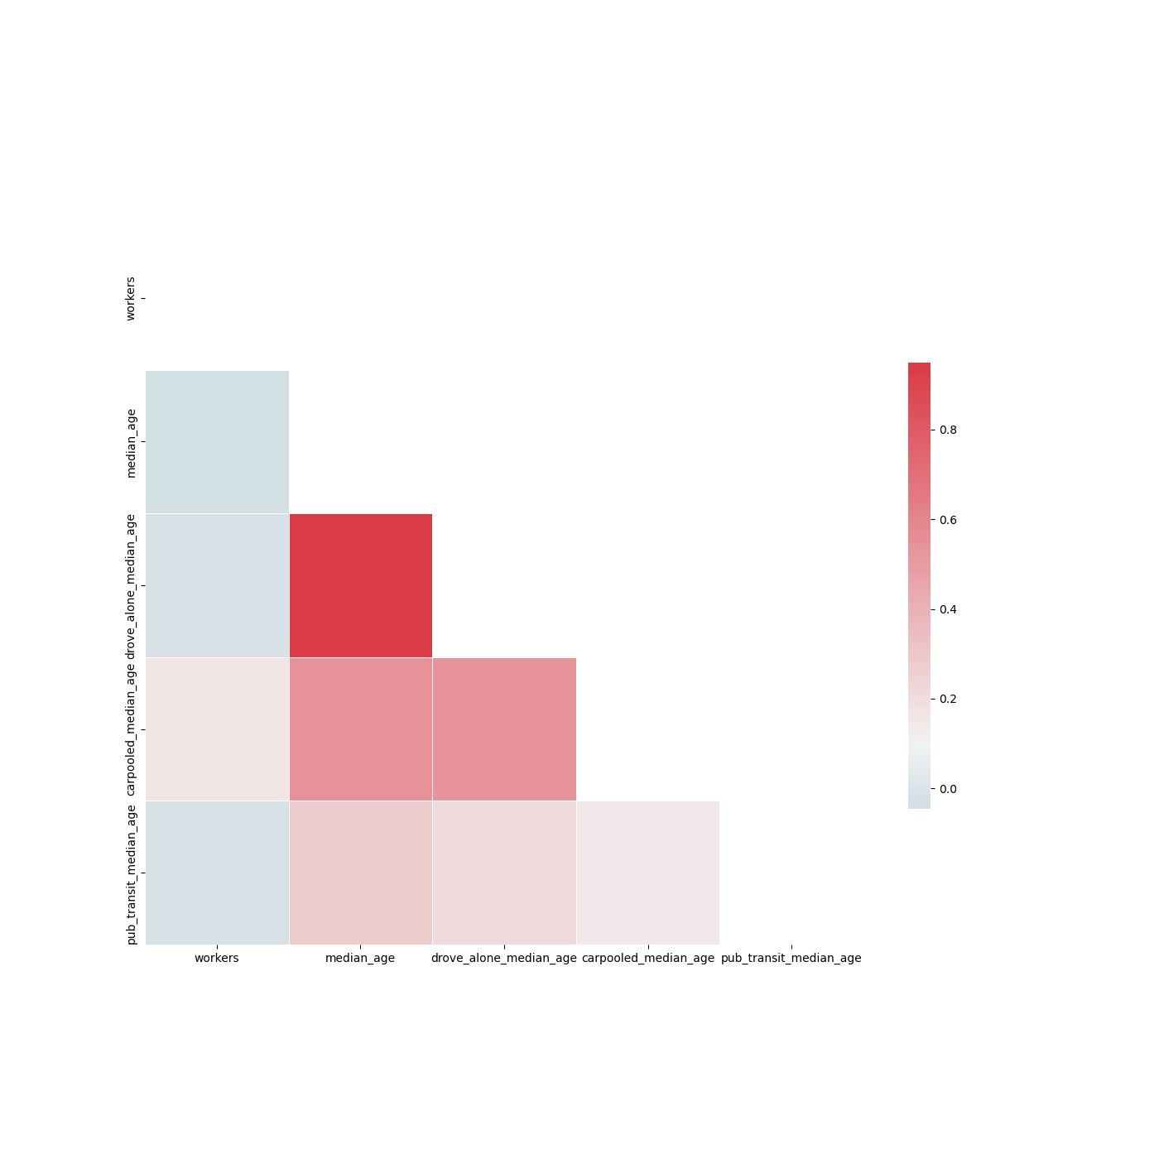
Are There Any Correlations Between Median Age for Each Mode?
Once again, the overall median age is highly correlated with the median age of people who Drove Alone. This is a very similar result to the previous correlation chart.

Slide 17
How Long Does It Take People To Get To Work?
There’s a fairly even distribution among the time ranges it takes to travel to work. Interestingly, the time range of 25-29 minutes is consistently one of the lowest.

Slide 18
Conclusion / Next Steps
Overall, most people drive alone to work as it is the mode of transportation that takes the least amount of time on average.
The coasts generally have higher commute times, specifically the east coast.
Ages for commuters are more skewed towards middle aged while travel times for commuters are more evenly spread.
Update when new data is added
Add more factors (ability to speak English, arrival time at work, etc.)
Look to data beyond Census: are there trends in zip codes and in cities?

